Slide 1






MARKET & QUALITY LANDSCAPE
Autonomous
Vehicle
Data Annotation
The market is scaling fast — but label quality is
the discipline that actually gates safe perception.
A landscape brief for engineering & ML teams
https://www.graveiensai.com/

Slide 2
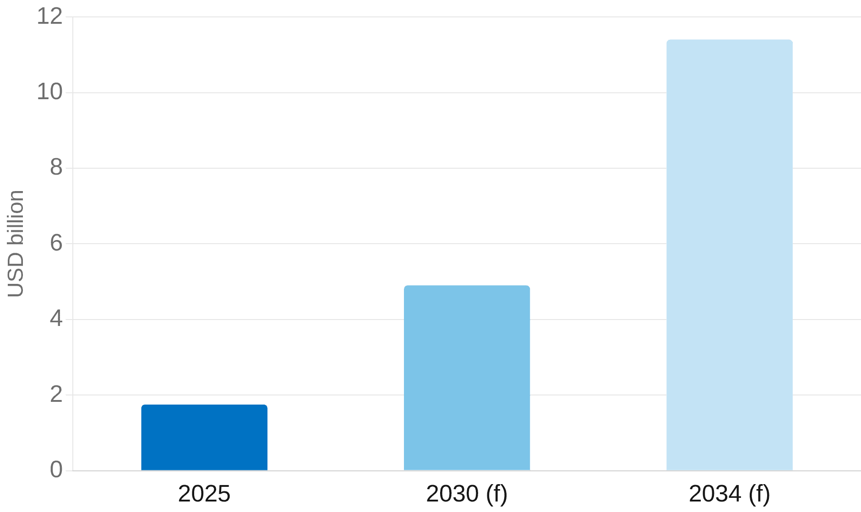



MARKET SIZE
The market at a glance
AV data-annotation segment · USD
projected at 23.1% CAGR to
$1.75B
billion
2034
AV driving-data annotation segment,
2025
38.2% image annotation share
20.3% CAGR to 2030, broader
market
$57.6B
data-labeling solutions & services market by
2030
Source: Grand View Research & Mordor Intelligence (2025–26)
https://www.graveiensai.com/

Slide 3
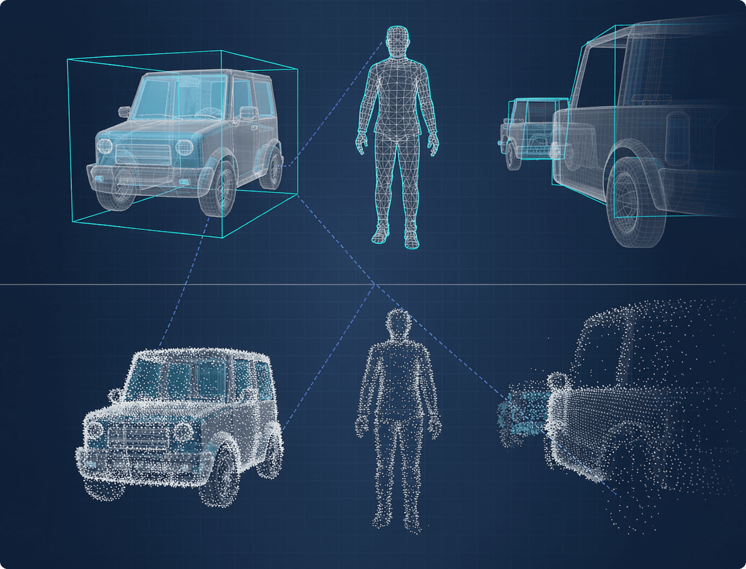






MODALITIES
Why AV data is not ordinary labeling
Perception needs many label types at once — each with its own precision demands, tooling and
cost.
LABEL TYPES IN AN AV STACK
2D image frames
38.2% share
3D LiDAR / point-cloud cuboids
Lane & drivable-area
Semantic segmentation
Sensor fusion
3D cuboid work resolves objects as small as 1 cm.
Fusing camera + point cloud into one annotated
frame
Source: Anolytics / Basic AI 3D annotation guides (2025)
https://www.graveiensai.com/

Slide 4
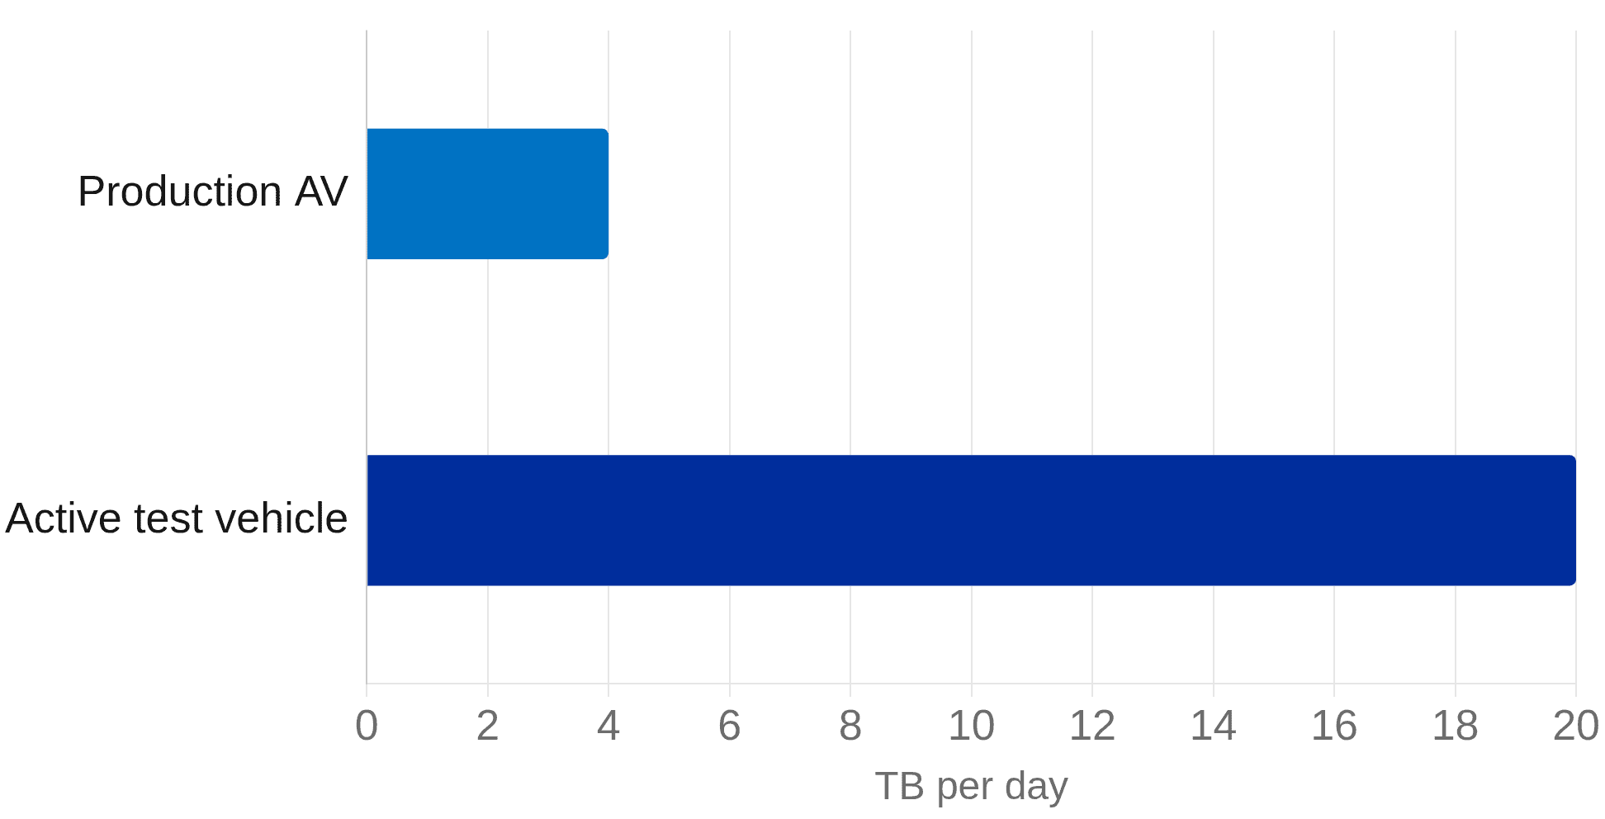



UNIT ECONOMICS
Data volume vs. unit economics
The tension is total sensor volume against a per-object labeling price.
Sensor data per vehicle · TB / day
capture, before labeling
4 TB
generated per production AV per
day
20 TB / day · active test fleet
500–7,000 TB / vehicle /
year
$0.121
Source: Tuxera & Premio (2025); provider 3D pricing
from, per annotated 3D cuboid
https://www.graveiensai.com/

Slide 5







PIPELINE
Inside the annotation pipeline
Five stages turn raw sensor capture into a training-ready dataset — with quality control built in at every
step.
01
02
03
04
05
Sensor capture
Auto-
Human review
Multi-round QA
Training-ready
Fleets log cameras,
prelabeling
Annotators correct &
Consistency &
set
LiDAR & radar
Models draft boxes &
refine
agreement checks
Versioned data for
masks
perception models
Active learning closes the loop: model uncertainty flags the next frames to annotate first.
Source: Basic AI / Damco AV annotation guides (2025)
https://www.graveiensai.com/

Slide 6



AUTOMATION
Automation and the foundation-model shift
Large models draft the labels; engineers and annotators still own correctness.
What automation does
What humans still own
—
Pre-annotates frames from large
—
Review and correct edge cases and rare
foundation models
scenes
—
Cuts labeling cost and turnaround time
—
Resolve ambiguity the model cannot
settle
—
Cross-modal consistency checks catch
human-in-the-loop
conflicts
handoff
—
Own quality sign-off and safety validation
Source: Voxel51 auto-labeling guide (2026)
https://www.graveiensai.com/

Slide 7
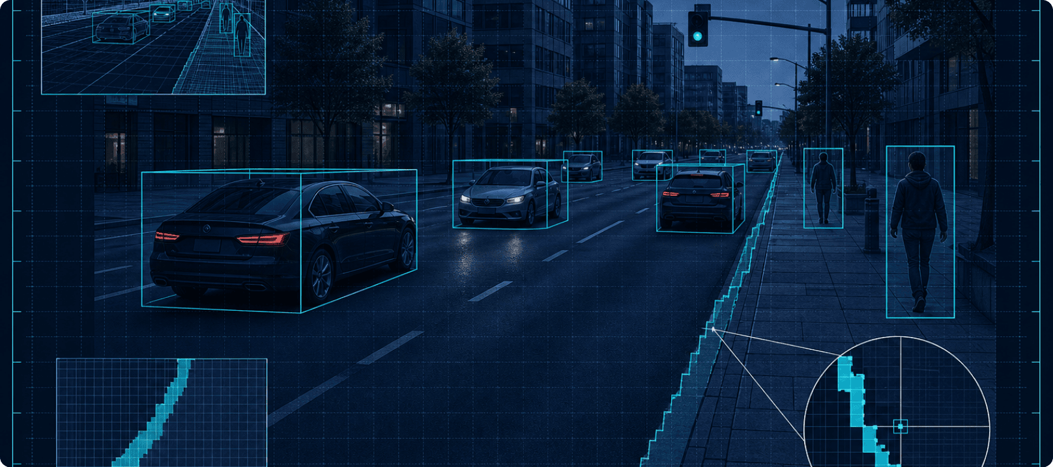



QUALITY & SAFETY
Quality is the safety gate
ANNOTATION-ACCURACY SLA, SOME AV
PROVIDERS
99.9
%
Inter-annotator agreement sets a hard ceiling on
1-pixel precision required at object edges
the accuracy any perception model can reach.
Multi-round QC across every batch
Engineered into the perception validation
loop
Source: arXiv 2511.15859 (annotation quality for safe perception)
https://www.graveiensai.com/

Slide 8



BUILD VS. BUY
Who labels the data: build vs. buy
In-house team
Third-party platform
Control
Full ownership of data and process
Shared under strict contracts
Scalability
Slow to ramp; capped by hiring
Elastic; bursts absorbed on demand
Cost model
Fixed headcount, predictable
Per-object pricing, variable
AV tooling
Built to your exact schema
Scale AI · Appen · Labelbox ·
SuperAnnotate · Sama
90%+ of leading US AI labs use Labelbox for post-training and model evaluation.
Source: Datazn / Transpire vendor rankings (2026)
https://www.graveiensai.com/

Slide 9

TAKEAWAYS
What this means for engineering teams
1
2
3
Engineer the pipeline
Make QA a metric
Automate the routine
Treat labeling as part of perception,
Track inter-annotator agreement
Let model pre-labels cut cost;
not a vendor afterthought.
and SLAs as first-class model
reserve humans for the edge cases.
metrics.
https://www.graveiensai.com/

